Slide 1
MCA PROJECT PRESENTATION
Campus Event Management
& Feedback Analyzer
A Python-powered web application for campus events
Abesh Chandra Sarkar | BWU/MCA/26/048
Department of Computational Sciences
Problem Solving using Python | MCA17400

Slide 2
PROJECT OVERVIEW
Introduction
The campus event challenge
The proposed application
• Technical fests, seminars, workshops and cultural programmes are central to university life.
• Manual workflows using spreadsheets and paper forms are time-consuming and error-prone.
• A web-based system built entirely in Python.
• Admins create events; students register and submit feedback.
• Visual analytics help organizers understand event performance.
TECHNOLOGY FOUNDATION
Python
Flask
HTML / CSS
Pandas
Matplotlib
02

Slide 3
THE PROBLEM
Problem Statement
01
02
03
No central system
Duplicate entries
No capacity control
Event registrations are scattered across tools.
Repeated registrations can cause confusion.
Events may exceed their participant limit.
04
05
06
Manual feedback
Limited reporting
Date errors
Paper feedback is difficult to summarize.
Organizers lack quick visual performance reports.
Past-dated events may be created accidentally.
03

Slide 4
WHAT THE PROJECT AIMS TO ACHIEVE
Project Objectives
OBJECTIVE 01
OBJECTIVE 02
OBJECTIVE 03
Create and manage campus events through a web platform
Enable student registration with real-time capacity tracking
Prevent duplicate registrations and enforce participant limits
OBJECTIVE 04
OBJECTIVE 05
OBJECTIVE 06
Collect 1–5 star feedback with optional comments
Use Pandas to calculate event-wise average ratings
Generate charts with Matplotlib
OBJECTIVE 07
OBJECTIVE 08
OBJECTIVE 09
Handle invalid IDs, duplicate entries and full events
Persist records in CSV files
Provide a responsive browser-based interface
04

Slide 5
COVERAGE AND BOUNDARIES
Scope of the Project
Project coverage
Target users
Current limitations
• Full lifecycle: create → register → feedback → analyze
• Browser-based interface for different devices
• CSV-based persistence; no external database required
• Admin creates events; students register and give feedback
• Students: register, cancel registrations and submit feedback
• Event organizers / admin: create events, manage participants and view analytics
• No login or authentication system
• CSV storage is not intended for very large-scale use
• No email/SMS notifications or payment gateway
• Designed for a single institution
05

Slide 6
BACKGROUND
Literature Review & Existing Systems
Existing system | Strength | Limitation
Google Forms + Sheets | Simple forms and response collection | No built-in capacity enforcement, duplicate prevention or dashboard
Eventbrite | Event management and ticketing | Paid service; not tailored to campus workflows
Excel / Spreadsheets | Flexible data storage | Manual entry; limited automation and analysis
College notice boards | Event announcements | One-way communication; no registration tracking
Gaps identified
Project response
• No integrated free Python workflow for registration, feedback and analytics.
• Limited custom exception handling and locally generated charts.
• Combines the core workflow in one lightweight application.
• Uses Python, CSV storage, Pandas and Matplotlib.
06

Slide 7
THE SOLUTION
Proposed System
Event management
Student management
Registration
Create events with ID, name, future date, venue and capacity
Maintain student ID, name, email and department
Register students with automatic capacity checks
Smart validation
Feedback
Analytics dashboard
Block duplicates, past dates and over-capacity registrations
Collect one 1–5 star rating and optional comment per event
Show event, student, registration and rating summaries
Visual charts
CSV data store
Security measures
Bar chart, rating histogram and participation graph
Persist events, students, registrations and feedback
Input validation, XSS prevention, CSP headers and session protection
07

Slide 8
DEVELOPMENT APPROACH
Project Methodology
ITERATIVE / MODULAR
DEVELOPMENT STEPS
Category | Technology
Programming language | Python 3.x
Web framework | Flask
Frontend | HTML5, CSS3
Data analysis | Pandas
Visualization | Matplotlib
Storage | CSV files
Development environment | VS Code
Version control | Git
Package manager | pip / venv
1
Define data models: Event, Student, Registration and Feedback
2
Build the CSV storage layer
3
Create Flask routes and business logic
4
Design HTML templates and CSS
5
Integrate Pandas and Matplotlib
6
Add validation, error handling and security headers
7
Test and fix defects
08

Slide 9
ARCHITECTURE AND DATA FLOW
Project Internal Structure
1. SYSTEM ARCHITECTURE (MVC)
2. DATA FLOW
Browser /
User
Flask
Server
CSV
Storage
User
form
Flask
route
Validate
Model /
CSV
Views: HTML templates • Models: Python classes • Data: CSV files
Invalid input → error message; valid input → save and render result.
3. MODULE STRUCTURE
4. CSV DATA SCHEMA
app.py · Main application
CSV file | Key fields
EVENTS | event_id, name, date, venue, max_participants
STUDENTS | student_id, name, email, department
REGISTRATIONS | reg_id, event_id, student_id, reg_date
FEEDBACK | feedback_id, event_id, student_id, rating, comment, submitted_at
Events
Students
Registration
Feedback
Analytics
Each module owns a focused set of operations.
Relationships: Events ↔ Registrations ↔ Students; Events ↔ Feedback.
09

Slide 10
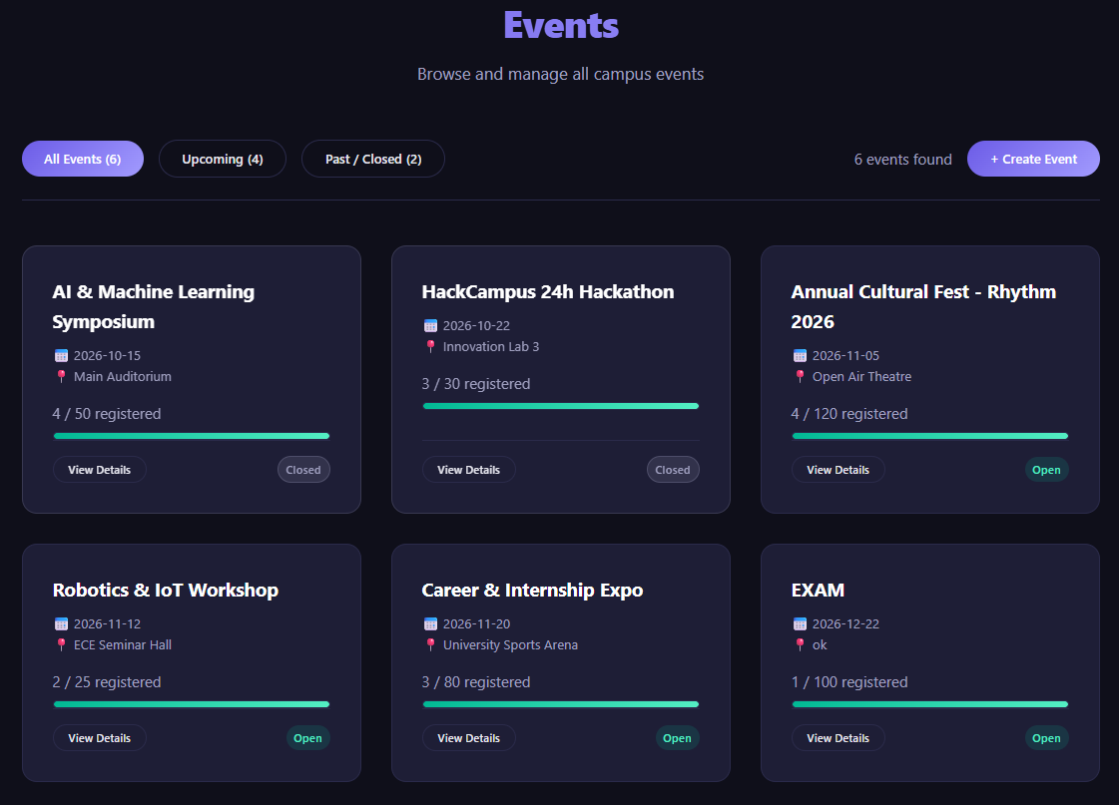
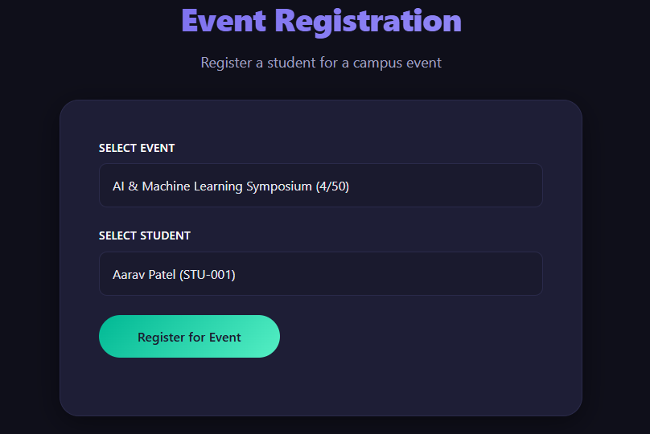
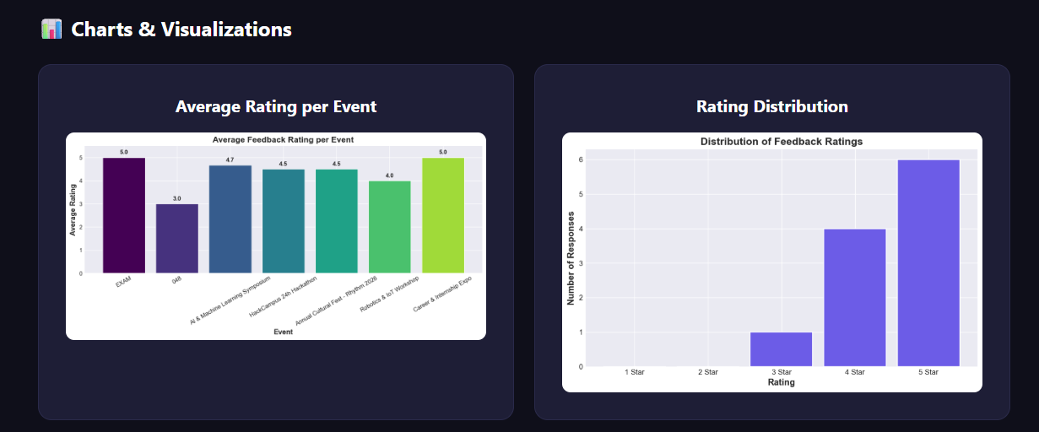
MAJOR MODULES AND FUNCTIONALITY
Implementation
01 Event management
• Create events with unique ID, future date, venue and capacity
• Reject past dates, duplicate IDs and invalid IDs
02 Student management
• Add student ID, name, email and department
• Prevent duplicate student IDs and email addresses
03 Registration
• Register and cancel student registrations
• Custom errors: DuplicateRegistrationError,
EventFullError, InvalidEventIDError, InvalidStudentIDError
04 Feedback
• Collect a 1–5 star rating and optional comment
• Enforce one feedback entry per student per event
05 Analytics
• Pandas: average ratings, registration totals and participation
• Matplotlib: rating bar chart, histogram and participation
line graph
10

Slide 11
VALIDATION OUTCOMES
Testing and Results
Test | Scenario | Observed outcome | Status
TC01 | Create event with future date | Event created | PASS
TC02 | Create event with past date | Past date rejected | PASS
TC03 | Register for a valid event | Registration successful | PASS
TC04 | Duplicate registration | Duplicate blocked | PASS
TC05 | Register when event is full | Capacity limit enforced | PASS
TC06 | Submit valid feedback | Feedback saved | PASS
TC07 | Submit duplicate feedback | Duplicate blocked | PASS
TC08 | Add student with duplicate email | Duplicate email rejected | PASS
TC09 | Generate analytics charts | Charts displayed | PASS
TC10 | Register with invalid event ID | Invalid ID rejected | PASS
10/10
0
3
Test cases passed
Failures reported
Analytics chart types
11

Slide 12
PROJECT ACHIEVEMENTS
Conclusion
The project demonstrates how Python can address a practical campus-management problem through a focused web application.
Web application
Built with Python and Flask
Object-oriented design
Event, Student, Registration and Feedback classes
Persistent storage
CSV file handling
Data analysis
Pandas aggregate calculations
Visualization
Matplotlib bar charts, histograms and participation graphs
Robustness
Custom exception handling for common edge cases
Interface
Responsive web interface with validation and security headers
12

Slide 13
POSSIBLE EXTENSIONS
Future Scope
Authentication
Student/admin login with role-based access
Database
Migrate CSV data to SQLite or PostgreSQL
Notifications
Email confirmations and event reminders
Mobile app
Android/iOS app using Flutter or React Native
AI recommendations
Suggest events based on participation history
Report export
Download analytics as PDF or Excel
Cloud deployment
Host on a cloud platform
Discussion forum
Post-registration student discussions
Photo gallery
Share event photos after events
Calendar integration
Sync events with Google Calendar
13

Slide 14
DOCUMENTATION AND LEARNING RESOURCES
References
1
Python Official Documentation — https://docs.python.org/3/
2
Flask Documentation — https://flask.palletsprojects.com/
3
Pandas Documentation — https://pandas.pydata.org/docs/
4
Matplotlib Documentation — https://matplotlib.org/stable/contents.html
5
Python CSV Module — https://docs.python.org/3/library/csv.html
6
HTML Reference — https://developer.mozilla.org/en-US/docs/Web/HTML
7
CSS Reference — https://developer.mozilla.org/en-US/docs/Web/CSS
8
Gaddis, T. — Starting Out with Python (4th Edition), Pearson Education
9
Lutz, M. — Learning Python (5th Edition), O'Reilly Media
10
Grinberg, M. — Flask Web Development, O'Reilly Media, 2018
11
Real Python Tutorials — https://realpython.com/
12
GeeksforGeeks — Python Programming Language
14

